Slide 1
Computational Statistic Project
Application of Extended and Ensemble Kalman Filters to two particular cases : Lorenz System and Thomas Attractor
Laurenti Argento Carlo - Svagna Marcello A.A 2022/23

Slide 2
Idea of the Project
Approach to the problems:
Show the analytical time evolution of the systems.
Analyze the filter algorithm to find out the correct parameters to implement.
Sample measurements with noise from the analytical solution.
Apply the filter algorithm to the two systems.
Discuss errors and results according to the expected physical behaviour.

Slide 3
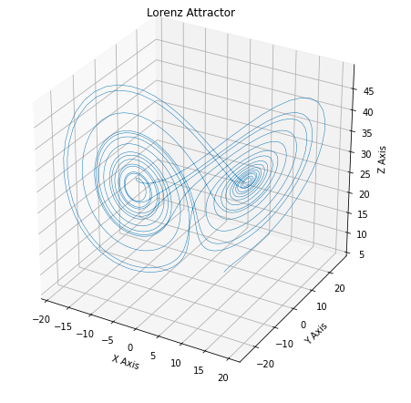
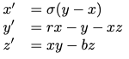
Lorenz System
From literature, we know that this is the time evolution of Lorenz System with a specific choice of the parameters (sigma, r, b) of the PDE.

Slide 4
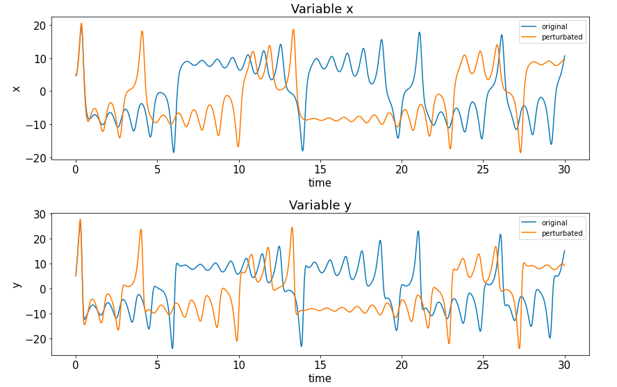
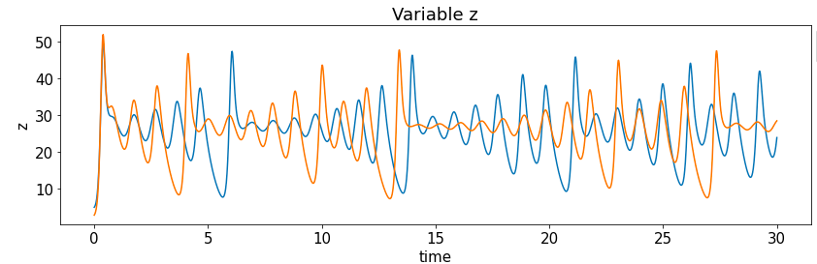

Dealing with perturbations
From literature, we know that with a little noise on the initial conditions, the evolution of the system changes completely.
Our aim is to fix this inconvenience through the implementation of a Kalman Filter.
Here are reported the graphs representing the evolution of the original system compared to the perturbed one.

Slide 5
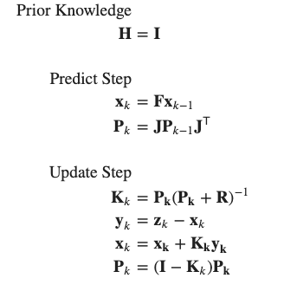
Kalman Filters Implementation
To implement the Kalman Filter algorithm we need to sample some measurements (which we call: z_k) form the analytical equations.
We decided to sample 40 measurement in a range of 2000 time steps (30 seconds).

Slide 6
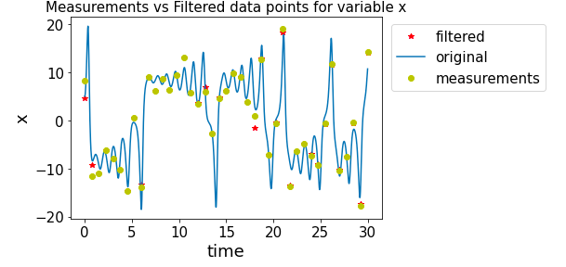
Extended Kalman Filter
As a first trial, we decided to use an Extended Kalman Filter.
The result for the estimate of variable x is reported on the right.
The most important feature of this kind of filter is that it can be used to tackle also non-linear systems.
This is done through the computation of the Jacobian Matrix (J in the previous scheme).

Slide 7
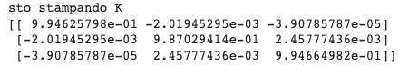
Analysis of the results
By plotting the error of the filtered points against the error between the original system and the perturbate one, we can see that we have a clear improvement in terms of overall precision.
However, from both looking at the previous graph and also from analyzing the diagonal of the Kalman Gain Matrix (K[i,i] ~ 1), we noticed that:
the measurements have a lot of influence in the filtered point estimate, thus affecting the reliability and the effectiveness of our model.

Slide 8
Ensemble Kalman Filter
The approach of the Ensemble Kalman Filters is pretty much the same as the one for the EKF: the only difference relies on the fact that instead of taking a single measurement as a guess, one samples N points from a Gaussian distribution and then applies the filtering to every point; the final filtered-estimate will be given by the mean of each filtered cluster of points.
x0 is the EKF measurement while P0 is the sampling error covariance matrix

Slide 9
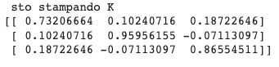
Comparison between EKF and EnKF
Although the result for the EnKF is similar to the one for EKF in terms of the error, the EnKF filtering is more indipendent from the measurements and so more relevant and statistically reliable.

Slide 10
Possible improvements
How can we achieve better results for our system ?
More accurate numerical integration (from EE to RK methods).
More measurements (all the variables change very fast w.r.t. time).
Implementation of other types of KF.
Decreasing noise in sampling measurements.

Slide 11
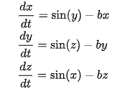
Thomas Attractor
We then decided to analyze the time evolution of the Thomas Attractor, with b = 0.208.

Slide 12
Different system, same problem, same approach

Slide 13
Extended Kalman Filter results :
The results for the EKF applied to the Thomas System are good:
even if for variable "x" there is still a strong displacement in favour of measurements against the dynamic evolution of the system, for the other variables the filtering process achieves good results in terms of system approximation and in bringing the error estimate closer to 0.

Slide 14
Ensemble Kalman Filter results :
Before moving on to the EnKF, we tried an improvement trial to the bare EKF by using a RK4 method for the approximation of the system. Unfortunately, this didn’t lead to any noticeable improvement.
When using the EnKF, instead, as one can easily observe from both the graph and the error plot, the outcome of the prediction is really good.

Slide 15
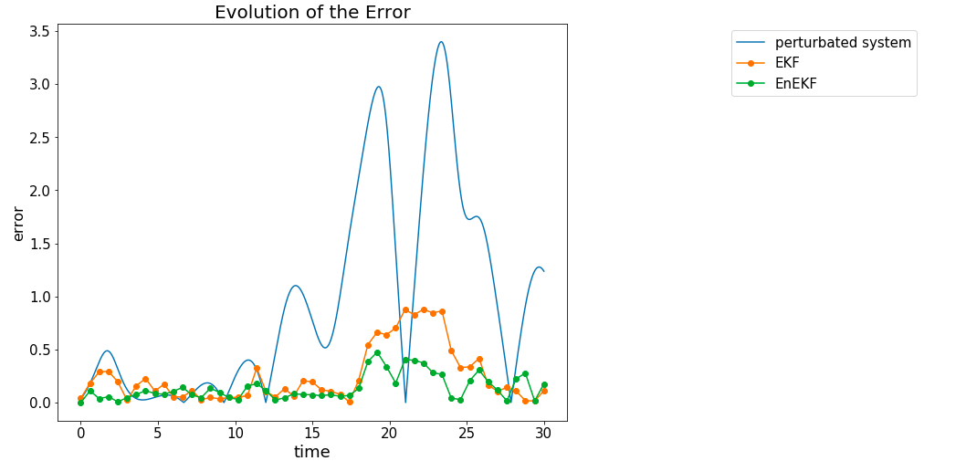
Final Considerations and comparison
By looking at the graph, one can observe how the EnKF filter for the Thomas system improves significantly the estimate given by the bare EKF algorithm.
In general, for the EnKF, the filtered points approximate a.e. better the system equations than the measurements: for this reason we can state that our approach gives us satisfying results and works in an appropriate way.
Morover, reducing the noise covariance matrix for the measurements sampling,
the EnKF estimates get better and better,
still remaining not completely dependent upon the measurements themselves
and still guaranteeing the proper functioning of the algorithm.

Slide 16
Sources and related paperwork
Information and guidelines for our project
Google Colab and Jupiter as working interface, where we wrote our two working Notebook
The article “PyDA: A Hands-On Introduction to Dynamical Data Assimilation with Python” , link : https://www.osti.gov/pages/servlets/purl/1737509
The GitHub repository “deeptime”
Chapter 10 from ClassNotes_CS_2022

